Slide 1
Milk recording in Czech republic
Daniel Falta, Tomáš Kopec

Slide 2
Breeding structure in CZ
Czech Moravian Breeders Assoc.-CMBA: service organization – technical database managing and milk control testing
Breedres Associations – owners of HB
Farmers – owners of milk data and cows
AI stations – owners of bulls (privat companies)

Slide 3
Czech Ministry of agriculture (34%)
Central database (HIT databank)
Holstein association (23%)
Czech Morav.
Breeders Assoc.
(HRADISTKO)
Fleckvieh association (23%)
Milk control labs,
BV estimation
IG lab
Methodical leading of the animal breeding
Etc…
1 union in each region, all kinds of animals, only „voluntary“ group i.e.
South Moravian breeders union
Regional breeders union (5%)
Pig breeders association
Sheep a. Goat association (14%)
PLEMDAT database
(100 % - Hradistko)
Beef breeds association
data
AI organizations + milk performance
CRV CZ
Natural
Plemo
Reprogen
ISB Genetic
AGRO Merin
Chovservis
Jihocesky Chovatel
Plemko (Montbeliarde)
Impuls
FARMERS (530 000 cows in total/ 175 000 FV HB cows)

Slide 4
Dairy cattle and milk recording in CZ
CZ member of ICAR
96+ % of dairy cow in milk control system (monthly recording of milk yield)
Base for genetic evaluation – estimation of BV
Data managing, processing and genetic evaluation by one organization – CMBA
Connected to the international eval.
– Interbull (Holstein), CZ/DE/AT (Fleckvieh)

Slide 5
Milk recording
1 laboratory for milk analysis (3.5 milion samples/yr)
1 700 dairy farms (+- 350 000 cows)
Milk recording scheme:
  Once a month, method A…
All data collected in Czech Moravian Breeders Association (CMBA)

Slide 6
Milk recording
Kg of milk yield – on farm measurement by inspector
Milk sample
  Milk components – central laboratory
  Protein, fat, lactose, SCC, urea…etc.
  Extra sample for Total Count Microorganisms
  Methodology by ICAR (www.icar.org)

Slide 7
Milk recording
Methods: A4 only approved for genetic evaluation (A4 = milk recording by official inspector every 4 weeks)
  A4A: sum of all daily milkings (2 or 3 milkings/day)
  A4T: only one milking (possible only in case of 2 milkings per day; total milk yield was calculate by reg. eq.)

Slide 8
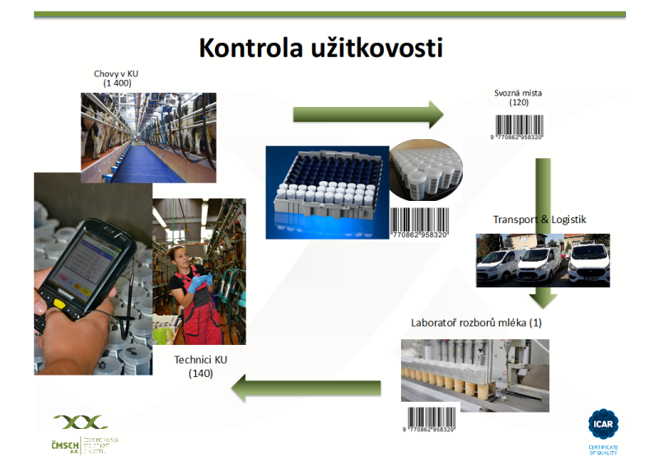
Farms (1400)
Collecting points (120)
Central milk laboratory (1)
Technisc (persons)
(140)

Slide 9
Milk control x Herdbook
90 % cows from milk recording are in herdbook (HB)
Herdbooks – 2 main Holstein and Fleckvieh
…rest – Jersey, Normande, Ayrshire, Braunvieh.
Divided on section (A,B,C..in Holstein also D)
Share of genes (blood) and parents HB section

Slide 10
Introduction milk data into HB
Data from milk recording (kg milks from farms measurements) and milk components from central laboratory – database
Herdbook – central database in CMBA
Daily update and merging laboratory and herdbook database (collected in CMBA)
+Central register of cattle (Evidence)

Slide 11
Herdbook (HB)
Breeders Associations (founded by breeeders)
Farm/breeder has to register in herdbook
Animals min. blood requirements (usually min. 51%)
Milk recording system A4/AT
fees (yearly, each cow registered in HB)
Newborn animals – automatically registered in HB

Slide 12
Herdbook - advantages
Pedigree certificate
Necessary for trade in bovine animals (live animals, insemination doses). Without HB – slaughter animal
Genetic improvement in population – only HB cow could by mother of AI bulls

Slide 13
Conclusion
Herdbook (breeders Association)
Milk recording (central service organization)
  Way to genetic improvement of population and internetional market with breeding animals (AI doses)

Slide 14
Thank you for your attention!

